Slide 1
Implementation of a Web 2.0-based Collaborative Model in a College Euclidean Geometry Class
(Paper 1 of 3)
Dr. Mokter Hossain
University of Alabama &
University of Nevada, Reno
&
Dr. Robert Quinn
University of Nevada, Reno
24th SITE International Conference-2013
New Orleans, LA, USA, March 25-29, 2013

Slide 2
Implementation of a Web 2.0-based Collaborative Model
in a College Euclidean Geometry Class
OVERVIEW
The Organization of this Presentation
INTRODUCTION
OBJECTIVE OF THE STUDY
THE MODEL AND PROCEDURE
FINDINGS
IMPLICATIONS OF THE MODEL
CONCLUSION

Slide 3
Implementation of a Web 2.0-based Collaborative Model
in a College Euclidean Geometry Class
INTRODUCTION
What is a Web 2.0 Technology?
A collaborative Web Development Platform.
Allows users to develop user-centered, participatory Web applications.
Example: Blogs, Wikis, LinkedIn, MySpace, Facebook, YouTube are successful applications of Web 2.0 technology.
Interactive Features of Blog
Users can add, control, and share information interactively and simultaneously on Blog, mostly for free.
Creating and editing on Blog are easy, fast, and requires only basic computing knowledge.

Slide 4
Implementation of a Web 2.0-based Collaborative Model
in a College Euclidean Geometry Class
INTRODUCTION
Objective Of the Study
Develop a collaborative Teaching-Learning platform
To establish new dimensions to enhance Math Education
Free, anywhere, anytime, and easy access
Make the technology usage more interesting
Share knowledge with each other
Purpose of the Study
Implementation of a Web 2.0-based Collaborative Model through a blogging activity, as a used as a supportive teaching-learning tool, in a college Euclidean Geometry Course

Slide 5
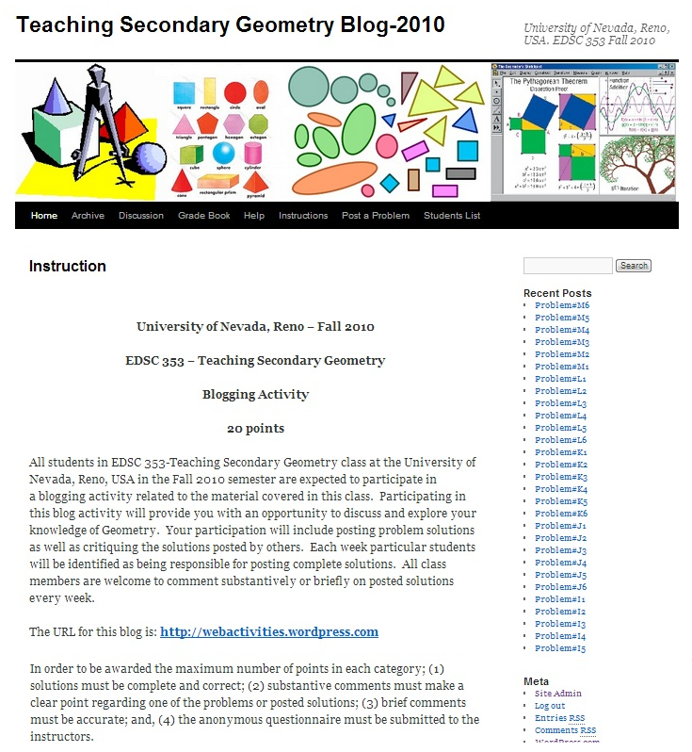
Implementation of a Web 2.0-based Collaborative Model
in a College Euclidean Geometry Class
The 2010 Blog

Slide 6
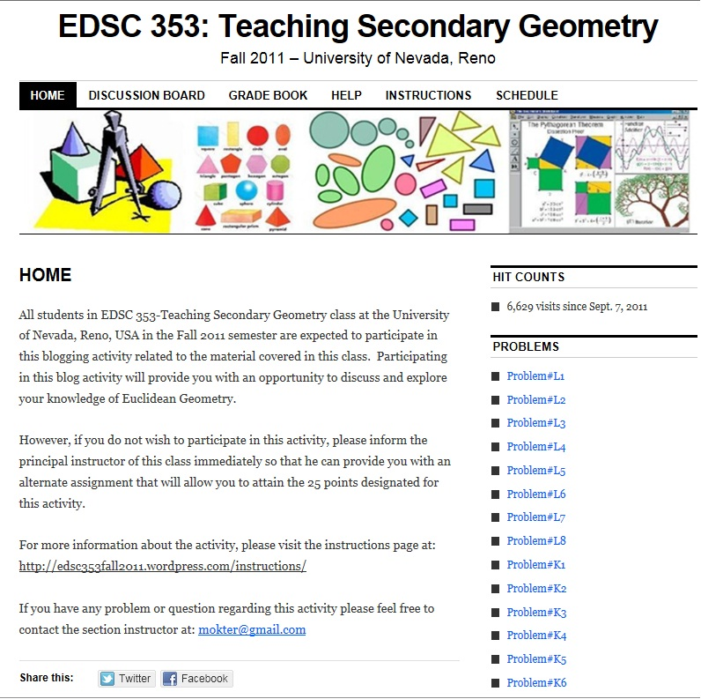
Implementation of a Web 2.0-based Collaborative Model
in a College Euclidean Geometry Class
The 2011 Blog

Slide 7
Implementation of a Web 2.0-based Collaborative Model
in a College Euclidean Geometry Class
Participants of the 2011 Blog
Table: Descriptive Statistics of Participants’ Age and Weekly Time Spent on the Internet
 |  |  | Age | Time Spent on the Internet
N | Male | 12
 | Female | 16
 | Total | 28
Mean |  |  | 26.43 | 22.43
Std. Error of Mean |  |  | 1.918 | 2.045
Median |  |  | 22.00 | 20.50
Mode |  |  | 20ª | 10ª
Std. Deviation |  |  | 10.149 | 10.823
Range |  |  | 41 | 55
a. Multiple modes exist. The smallest value is shown
Median of the total time spent on the Internet/week = 20.50

Slide 8
Implementation of a Web 2.0-based Collaborative Model
in a College Euclidean Geometry Class
Findings:
Finding-1:
Blogging activity was found enjoyable
Blogging activity was perceived to be effective in a college Euclidean Geometry course
Gender did not have a significant relationship with preservice secondary mathematics teachers’ attitudes toward or perceived effectiveness of using a blog
Both male and female students and teachers appear to benefit from using a blog as a supportive teaching-learning tool in a college Euclidean Geometry course

Slide 9
Implementation of a Web 2.0-based Collaborative Model
in a College Euclidean Geometry Class
Findings:
Finding-2: No significant difference by gender with regard to preservice mathematics teachers’ attitudes toward the blogging activity in a college Euclidean Geometry Course
Table: Wilcoxon-Mann-Whitney U Test Statistics for Attitude Scores on Participants’ Gender
 | Median Attitudes
Mann-Whitney U | 68.000
Wilcoxon W | 204.000
Z | -1.377
Asymp. Sig. (2-tailed) | .169
Exact Sig. [2*(1-tailed Sig.)] | .205ª
a. Not corrected for ties.
(N = 28, U = 68.0, p = .169 > .05); Non-Significant

Slide 10
Implementation of a Web 2.0-based Collaborative Model
in a College Euclidean Geometry Class
Findings:
Finding-3: No significant difference between participants’ attitudes toward the blogging activity and their self-reported total time pent weekly on the Internet for all purposes
Table: Wilcoxon-Mann-Whitney U Test Statistics for Median Attitude Scores on Time Spent on the Internet
 | Median Attitudes
Mann-Whitney U | 61.500
Wilcoxon W | 166.500
Z | -1.777
Asymp. Sig. (2-tailed) | .076
Exact Sig. [2*(1-tailed Sig.)] | .094ª
a. Not corrected for ties.
(N = 28, U = 61.50, p = .076 > .05); Non-Significant

Slide 11
Implementation of a Web 2.0-based Collaborative Model
in a College Euclidean Geometry Class
Findings:
Finding-4: No significant relationship between the participants’ cumulative quiz scores attained in the college Euclidean Geometry Course and their attitudes toward the blogging activity.
Table: Spearman Correlation Test Results on Median Attitude Scores
Spearman's rho |  | Cumulative Quiz Score | r_{s}
Cumulative Quiz Score | Correlation Coefficient | 1.000 | -.145
 | Sig. (2-tailed) | . | .461
 | N | 28 | 28
Median Attitudes | Correlation Coefficient | -.145 | 1.000
 | Sig. (2-tailed) | .461 | .
 | N | 28 | 28
(N = 28, r_{s} = -0.145, p = .461 >.05); Non-Significant

Slide 12
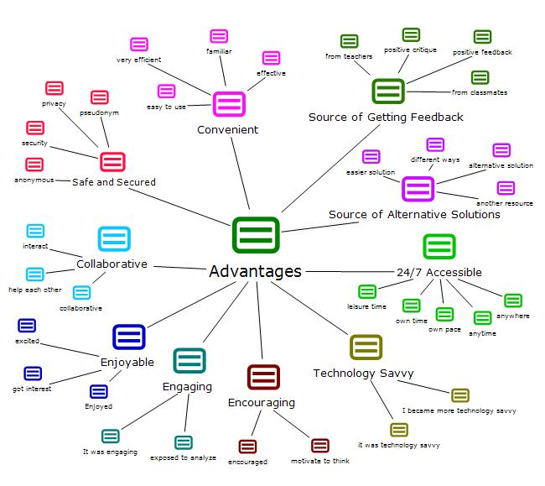
Implementation of a Web 2.0-based Collaborative Model
in a College Euclidean Geometry Class
Finding-5: A number of advantages of using a blog as a supportive tool in a Euclidean Geometry course

Slide 13
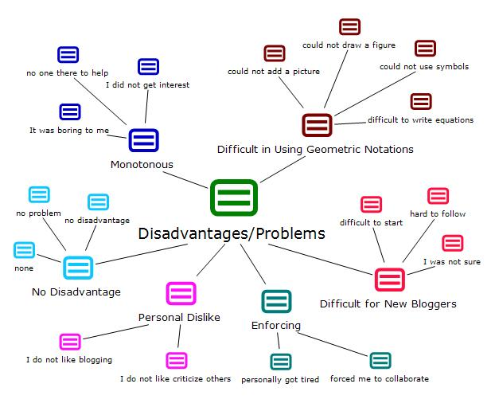
Implementation of a Web 2.0-based Collaborative Model
in a College Euclidean Geometry Class
Finding-5… : No mentionable disadvantages; Only a few minor problems

Slide 14
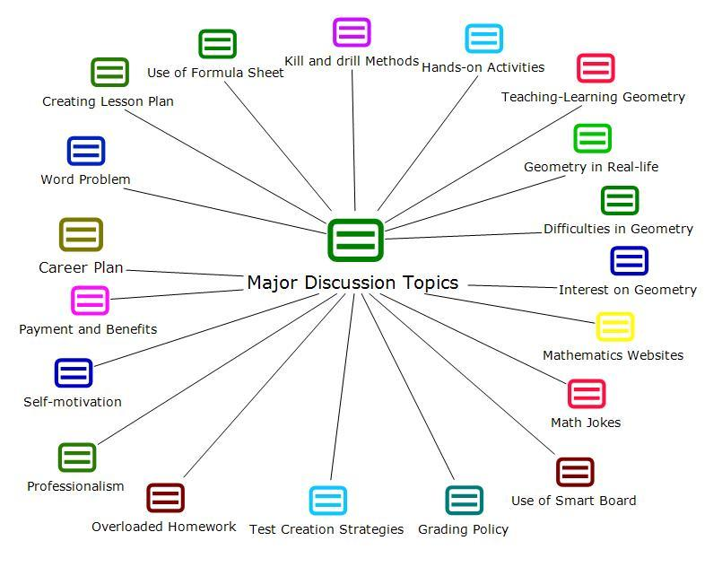
Implementation of a Web 2.0-based Collaborative Model
in a College Euclidean Geometry Class
Finding-6 : Blog was found as a Free Online Discussion Board

Slide 15
Implementation of a Web 2.0-based Collaborative Model
in a College Euclidean Geometry Class
Implications for Practice
No unfair advantages to male or female participants
Preservice teachers found it positive and effective
New teaching-learning tool – could be included in the schools, and teacher education curricula
A number of advantages; many of which match with the NCTM Principles and Standards
No major disadvantages/Only a few minor problems
Can develop collaborative teaching-learning environment
A free and public forum for online discussion

Slide 16
Implementation of a Web 2.0-based Collaborative Model
in a College Euclidean Geometry Class
Limitations and Delimitations of the Model
The study dealt with a single class of 28 students
The study has only about 51% chance of finding a significant mean difference between the groups, if it really existed
Euclidean Geometry problems that required participants using construction tools or uploading of images and graphs were avoided
Participants were asked to type mathematical formulas in plain text format

Slide 17
Implementation of a Web 2.0-based Collaborative Model
in a College Euclidean Geometry Class
Conclusions
Use of a blog in a College Euclidean Geometry Course is enjoyable and effective
No significant difference in the measures of attitude and perceived effectiveness on Gender and Course assessment
Numerous advantages. No mentionable disadvantages - only a few minor difficulties
Collaborative and motivational
Anytime, anywhere, easy accessible
Participants found blog as an open and public forum
Numerous potential to improve teaching-learning mathematics

Slide 18

Implementation of a Web 2.0-based Collaborative Model
in a College Euclidean Geometry Class
QUESTIONS & ANSWERS??
Please Discuss Online;
Or, Email at: mokter@gmail.com
Thank You

